Slide 1
Technology Networks for Conservation Agriculture: Kapchorwa, Uganda
Rita Laker-Ojok
Dominic Sikuku
Jennifer Lamb
SANREM CRSP
Technology Networks Workshop
Kapchorwa, Uganda
February 10, 2012
Notes:
Thank you for being here, I am excited to share with you the results of our study on networks for CA

Slide 2
What is the project?
Lead institution: University of Wyoming
Development and Transfer of Conservation Agriculture Production Systems (CAPS) for Small-holder Farms in Eastern Uganda and Western Kenya

Slide 3
Who are the implementing partners?
Universities:
University Of Wyoming,
Makerere University,
Moi University
Ngo’s:
AT Uganda,
Manor House,
Sacred Africa
Local Farmer Groups/Key Stakeholders

Slide 4
Core Principles of Conservation Agriculture
The three principles of
conservation agriculture
• Disturb The Soil As Little As
Possible.
• Keep The Soil Covered As
Much As Possible.
• Mix And Rotate Crops.

Slide 5
Disturb the soil as little as possible
In conventional farming, farmers plough and hoe to improve the soil structure and Control weeds. But in the long term, they actually destroy the soil structure and contribute to declining soil fertility.
In conservation agriculture, tillage is reduced to ripping planting lines or making holes for planting without disturbing the rest of the field. The ideal is to plant direct into the soil, without ploughing.

Slide 6
Keep the soil covered as much as possible
In conventional farming, farmers remove or burn the crop residues or mix them into the soil with a plough or hoe. The soil is left bare, so it is easily washed away by rain, or is blown away by the wind.
In conservation agriculture, crop residues left on the field, mulch and special cover crops protect the soil from erosion and limit weed growth throughout the year.

Slide 7
Mix and rotate crops
In conventional farming, the same crop is sometimes planted each season. That allows certain pests, diseases and weeds to survive and multiply, resulting in lower yields.
In conservation agriculture, this is minimized by planting the right mix of crops in the same field, and rotating crops from season to season that require different nutrients from the soil. This also helps to maintain soil fertility.

Slide 8
SANREM Principles and procedures
In working with our partners in the farming communities we have targeted for conducting research for the development of adapted Conservation Agriculture Production Systems (CAPS) we need to understand the value of our activities for community members, and how they perceive the benefits of what we are learning.
That is why we have created a local advisory council – this is why you are here today.

Slide 9
Principles and procedures
This is a research project. Our objective is to develop new knowledge that can be used by local partners to improve their production systems, and consequently their livelihoods and well-being.
We do not have the necessary resources to deliver the inputs and means for achieving development.
We are in the community to learn from community members and about their production systems. In the process, we should be helping the community learn more about their own resources and potentials and how they can build more sustainable and profitable production systems.

Slide 10
Principles and procedures
This project conducts research with individuals and communities is on a voluntary basis.
Successful learning occurs when individuals choose of their own accord to think and act in new ways.
Our job is to present and test new ideas and technologies with those communities and community members who are interested in actively learning about new ways to manage their resources.

Slide 11
Where we are in the process
This is a 4 year project. We have 3 years left.
We have done the baseline data collection to understand the local production system before the project, and to try to understand what people’s thinking about CA was before we started. Today’s presentation is to show you some of the results of that baseline study.
We have also completed the first year of experimental trials to begin testing CA principles in Uganda and those results are being analyzed. They will also be shared with you soon.

Slide 12
Introduction
Successful Conservation Agriculture requires:
Broad based support network
Change in mindset regarding agricultural production practices
Everyone has to be involved
Why we have tried to bring you all here today
The plow is a familiar sight in Kapchorwa
Notes:
Change in mindset? –CA means a considerable shift from the way things are currently done

Slide 13
Research Process
Focus Groups in 2010
Identify key contacts for agricultural production
List of 19 key actors
Survey conducted in 2010
97 farm households were asked about their key contacts for agricultural information/resources in Kwosir Sub-county
Kwosir and Kere Parishes
Follow up interviews conducted in 2011 with 19 individuals
Community agents
Agricultural service providers

Slide 14
Research Aims
Understand existing mindsets with regard to agricultural production
Especially with regard to conservation agriculture
Map the structure of agricultural production networks in Kapchorwa
Prioritized Identifying:
Key nodes in the network
For farmers
In the whole agricultural production network
Knowledge and beliefs about CA
Differences between farmers and service providers/community agents

Slide 15
Farmer Involvement in Agricultural Networks
Variable | Observations | Mean | Standard Deviation | Min Value | Max Value
Resource Contacts | 97 | 3.65 | 2.53 | 0 | 10
Information Contacts | 97 | 7.12 | 3.72 | 0 | 17
Notes:
Farmers generally have more contacts for information than for resources, as evidenced by the higher average and broader range. The maximum response for info is 17 v. 10 for resource contacts.

Slide 16
Key Resource Contacts for Farmers
Agent Type: | Number of Reports (Out of 97): | Percentage of Farmers Reporting Contact:
Veterinary Service provider | 58 | 60%
Vendor in a agro-vet shop | 53 | 55%
Neighbor/friend | 37 | 38%
Family Member | 36 | 37%
NGO/ Development Agent | 36 | 37%
Vendor in weekly market | 34 | 35%
Tractor owner/ animal traction provider | 31 | 32%
Government Extension agent | 25 | 26%
Agricultural researcher | 11 | 11%
Leader of farmer organizations | 8 | 8%
Vendor in a shop in urban center | 7 | 7%
Agricultural/Micro Finance Representative | 7 | 7%
Village/Subcounty chief | 4 | 4%
Teacher in village | 3 | 3%
Leader of women’s organization | 3 | 3%
Minister/Priest/Imam in village | 2 | 2%
Government Parastatals | 0 | 0%
Leader of youth organisation | 0 | 0%
Local Political leaders | 0 | 0%

Slide 17
Key Information Contacts for Farmers
Agent Type: | Number of Reports (Out of 97): | Percentage of Farmers Reporting Contact:
Family Member | 81 | 84%
Neighbor/friend | 72 | 74%
Veterinary Service provider | 62 | 64%
Vendor in a local agro-vet shop | 57 | 59%
Vendor in a shop in urban center | 53 | 55%
Vendor in weekly market | 52 | 54%
Tractor owner/ animal traction provider | 42 | 43%
Government Extension agent | 40 | 41%
NGO/ Development Agent | 36 | 37%
Village/Subcounty chief | 34 | 35%
Local Political leaders | 34 | 35%
Minister/Priest/Imam in village | 33 | 34%
Teacher in village | 32 | 33%
Agricultural researcher | 23 | 24%
Leader of farmer organizations | 13 | 13%
Leader of women’s organization | 12 | 12%
Agricultural/Micro Finance Representative | 9 | 9%
Leader of youth organisation | 5 | 5%
Government Parastatals | 1 | 1%
Notes:
-Importance of local actors advising on CA. Most frequently reported persons in the network are those who are close to where people live

Slide 18
Network Structure
Matched the farmer data (97) to Technology Networks Data (19)
Determine Influential Nodes:
Degree Centrality = Number of contacts for agricultural information
Betweenness Centrality = Score which indicates the extent to which an agent controls the transmission of information between contacts by measuring the extent to which a person mediates contact between others
Degree Centrality | Score | Rank | Betweeness Centrality | Score
NAADS Coordinator | 20 | 1 | Local Stockist | 28.25
Chief | 20 | 2 | Women’s Group Leader | 16.93
Couselor | 19 | 3 | Chief | 14.19
Local Agrovet* Women’s Group Leader* | 18 | 4 | NAADS Coordinator | 14.15

Slide 19
Knowledge and Beliefs about Agricultural Production
Focus on the Three Principles of CA:
Crop rotation
Maintaining a permanent crop cover
Minimizing tillage
Corresponding statements on questionnaire:
“Rotating crops is always best practice”
“One should maintain a permanent crop cover”
“Tillage causes land degradation”
Farmers indicated agreement on a scale of 1-5
5 = “strongly agree”
1= “strongly disagree”

Slide 20
Disaggregating Knowledge and Beliefs about Agricultural Production
Differences between farmers and community agents/service providers?
Farmers (n=97)
Service Providers (n= 19)
Differences between smaller and larger farmers?
Are small or large farmers more predisposed to CA?
Small farmer = 3 acres or less (n= 34)
Large farmer = more than 3 acres (n=63)
Differences between farmers with extension contact and without extension contact?
Extension might expose farmers to CA views?
Farmers with extension contact (n = 40)
Farmers without extension contact (n=57)

Slide 21
Knowledge and Beliefs about Agricultural Production
Beliefs about Agricultural Production |  | Agree | Uncertain/ neutral | Disagree
One should maintain a permanent crop cover Chi-square = 26.2 Significant at .001 | Small Farmers (34) | 14.7 | 44.1 | 41.2
 | Large Farmers (63) | 20.6 | 47.6 | 31.7
 | Service sector/ (19) community agents | 73.7 | 5.3 | 21.1
Tillage causes land degradation Chi-square = 12.2 Significant at .05 | Small Farmers (34) | 61.8 | 23.5 | 14.7
 | Large Farmers (63) | 52.4 | 38.1 | 9.5
 | Service sector/ (19) community agents | 73.7 | 0.0 | 26.3
Rotating crops is best practice Chi-square = 0.5 Not Significant | Small Farmers (34) | 94.1 | 5.9 | 0.0
 | Large Farmers (63) | 90.5 | 9.5 | 0.0
 | Service sector/ (19) community agents | 89.5 | 10.5 | 0.0

Slide 22
Rotating Crops is Best Practice
Notes:
Unanimously strong support for crop rotation

Slide 23
One Should Maintain a Permanent Crop cover
Notes:
-A considerable portion of farmers have not made up their minds as to whether one should maintain a permanent crop cover, while the service sector and community agents overwhelmingly agree this is a good idea.
-The number of undecided farmers presents an opportunity to present the case for cover cropping to farmers who have not made up their minds regarding maintaining a crop cover. However, the significant portion of small and large farmers who disagree with the principle means that strong evidence of the benefit of maintaining a crop cover be demonstrated to farmers.

Slide 24
Tillage Causes Land Degradation
Notes:
Again, this chart demonstrates the pattern of the service sector and community agents holding stronger opinions than farmers. Nevertheless, a majority of individuals across the categories agree that tillage causes land degradation. However, larger farmers seem less decisive. What do you think may be causing this large degree of uncertainty among larger farmers?
The fact that the majority agree with the idea that tillage causes land degradation

Slide 25
Impact of Extension Contact on Knowledge and Beliefs
One should maintain a permanent crop cover | Agree | Uncertain/ neutral | Disagree | Mean values
Farmers w/o contact (n=57) | 17.5 | 56.1 | 26.3 | 2.89 ª
Farmers with contact (n=40) | 20.0 | 32.5 | 47.5 | 2.68 ª
Service sector/community agents (n=19) | 73.7 | 5.3 | 21.1 | 3.95 ^{b}
Note= different letters in the same column are significantly different from one another
Notes:
Farmers with extension contact do not hold a different view than farmers without extension contact. Maintaining a permanent crop cover may be a priority message for extension. Alternatively, farmers without contact are more undecided, while more farmers with contact disagree that maintaining a permanent crop cover is a good idea. We should not read too much into this, but this could indicate that extension contact may not be currently promoting cover cropping.

Slide 26
Impact of Extension Contact on Knowledge and Beliefs
Tillage causes land degradation | Agree | Uncertain/ neutral | Disagree | Mean values
Farmers w/o contact (n=57) | 50.9 | 36.8 | 12.3 | 3.66 ª
Farmers with contact (n=40) | 62.5 | 27.5 | 10.0 | 3.78 ª
Service sector/community agents (n=19) | 73.7 | 0.0 | 26.3 | 3.84 ª
Note= different letters in the same column are significantly different from one another
Notes:
Farmers with extension contact do not hold a different view than farmers without extension contact. Farmers may have come to this conclusion through experience, and not with the assistance of extension.

Slide 27
Mapping Knowledge and Beliefs in agricultural Production Networks

Slide 28
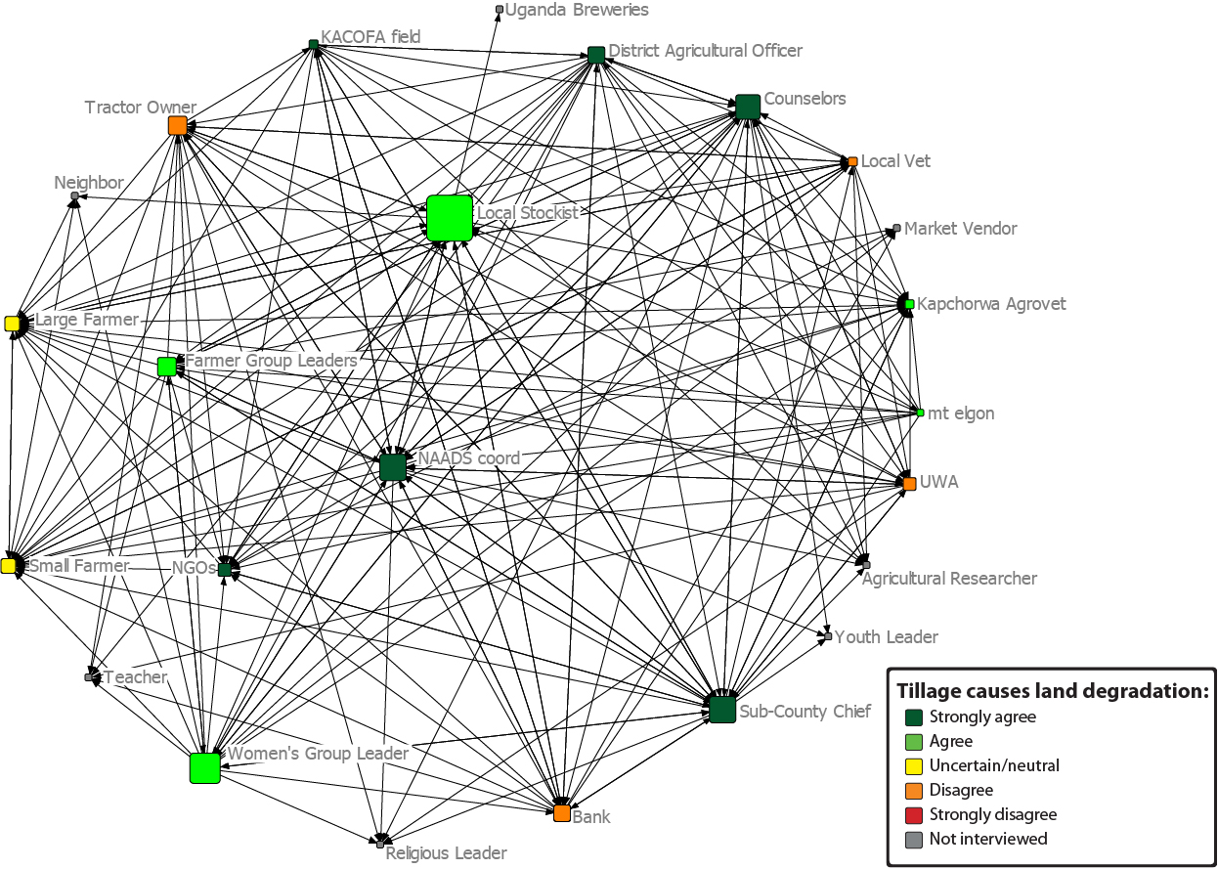
“Tillage causes land degradation”
Mapped Network of Agricultural Information flows and actor beliefs

Slide 29
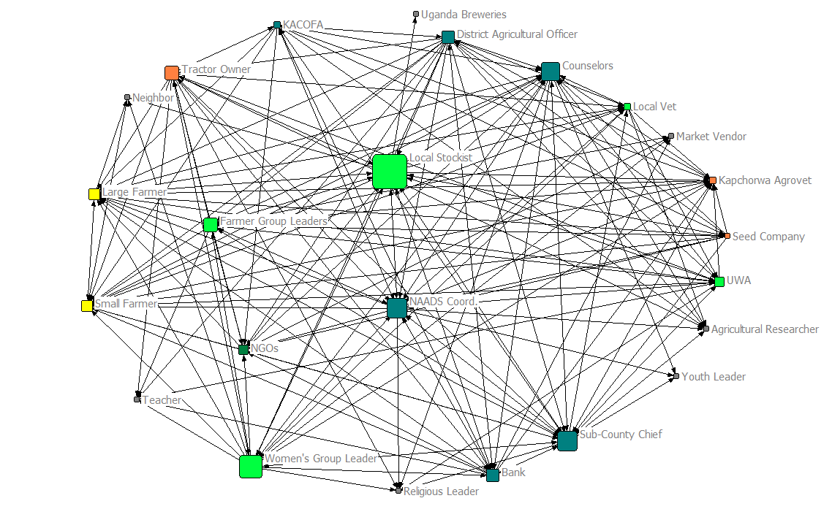
“One should maintain a permanent crop cover”
Strongly agree
Agree
Uncertain/neutral
Disagree
Strongly disagree
Not interviewed
Mapped network of information flows and beliefs

Slide 30
How can we use this information to promote CA within the agricultural production network?
Who are the important constituencies to be reached?
Small farmers? Large farmers? Agro-vets? Etc.
What strategies are most appropriate for these groups?
Education? Demonstrations? Etc.
Who are the key transmitters of information in the network?
Are there others who were not mentioned?
How should we enlist the assistance of these persons to better connect farmers to information and resources?
About agriculture? About CA?
What are the remaining challenges (agronomic, economic, practical, etc.) to be resolved for successful CA in Kapchorwa?
Who needs to be brought together to resolve these issues?

